Slide 1
Amazon Sales Data Analysis report
Swapnil GAvali

Slide 2
Objective
Understand the Significance of Sales Management: Recognize the increasing competition in the market and the necessity for enhanced distribution methods to reduce costs and boost profits.
Highlight the Importance of Sales Management in Enterprises: Acknowledge that sales management is currently the most crucial function in commercial and business enterprises.
Explore ETL Processes: Implement Extract-Transform-Load (ETL) processes on the Amazon dataset to facilitate efficient data analysis.
Identify Sales Trends: Analyze sales data to extract month-wise, year-wise, and yearly-month-wise sales trends, providing a comprehensive understanding of the sales patterns.
Uncover Key Metrics and Factors: Employ data analysis techniques to identify key metrics and factors influencing sales, contributing to a deeper comprehension of the underlying dynamics.
Establish Relationships Between Attributes: Utilize data visualization tools such as Tableau or Power BI to illustrate meaningful relationships between various attributes, aiding in the identification of patterns and insights.

Slide 3
Benefits
By understanding sales trends month-wise, year-wise, and yearly-month-wise, businesses can make informed decisions related to inventory management, marketing strategies, and resource allocation.
The insights gained from the analysis contribute to better decision-making, helping organizations respond proactively to market dynamics and changing customer preferences.
Analyzing customer trends and satisfaction allows businesses to identify areas for improvement in existing products and services.
The data-driven approach facilitates the development of new and better offerings, aligning with customer expectations and market demands.
The analysis provides a comprehensive view of customer behavior and preferences, enabling businesses to tailor their strategies to meet specific customer needs.
Understanding customer demographics, purchasing patterns, and preferences helps in building targeted marketing campaigns and personalized customer experiences.

Slide 4

Quick Insights
Total Revenue
137M $
Total Profit Margin
44M $
Total Cost
93M $
Total Units Sold
513K
Country Count
76

Slide 5
Total sales by year
The total cost exhibited a substantial decrease, declining from 1,06,16,258.38 to 92,84,066.18, marking its most significant drop between 2010 and 2017.
Both the sum of total revenue and the sum of total cost experienced a downward trend, with a 19.46% decrease in total revenue and a 12.55% decrease in total cost observed between 2010 and 2017.
The steepest decline in this period was noted in the sum of total cost, showcasing a reduction from 1,06,16,258.38 to 92,84,066.18.

Slide 6
Units sold by year and item type
Between 2010 and 2017, Personal Care witnessed the most substantial surge in the sum of units sold, experiencing an impressive increase of 3,352.01%. In contrast, Beverages faced the largest decline, witnessing a significant decrease of 79.49%.
The most notable anomaly in the sum of units sold occurred in 2014, with Baby Food reaching a peak of 13,009 units.
The trend for Cosmetics in the sum of units sold started declining in 2015, showing a reduction of 36.25% (1,032 units) over the following two years.

Slide 7
Total revenue by item type
Cosmetics constituted a significant portion of the total revenue, accounting for 26.65% of the overall revenue.
With a sum of total revenue amounting to 3,66,01,509.60, Cosmetics held the highest revenue among all item types. Remarkably, this figure was 7,746.30% higher than Fruits, which recorded the lowest sum of total revenue at 4,66,481.34.
The sum of total revenue across all 12 item types exhibited a broad range, spanning from 4,66,481.34 to 3,66,01,509.60, highlighting the diverse revenue contributions from different item types in the dataset.

Slide 8
Profit by item type
With a sum of total profit amounting to 1,45,56,048.66, Cosmetics emerged as the leading item type, surpassing all others. Impressively, this figure was 11,980.19% higher than the lowest sum of total profit, recorded by Fruits at 1,20,495.18.
Cosmetics played a significant role in the overall profit, contributing to 32.96% of the total profit.
The total profit across all 12 item types showcased a considerable range, spanning from 1,20,495.18 to 1,45,56,048.66, highlighting the diverse profit contributions from different item types in the dataset.

Slide 9
Units sold by region and item type

Slide 10
Total revenue by region and sales channel
In the Offline sales channel, Sub-Saharan Africa contributed significantly, making up 18.74% of the total sum of total revenue.
The average sum of total revenue per entry was higher for Offline sales (1,12,99,258.46) compared to Online sales (97,08,993.19).
The most significant divergence in the sum of total revenue for Offline and Online sales occurred in the Sub-Saharan Africa region, where Offline sales were 1,17,95,467.61 higher than Online sales. This indicates a notable disparity in revenue contributions between the two sales channels, particularly in Sub-Saharan Africa.

Slide 11
Average unit price and cost by item type
The average unit price and total average unit cost demonstrate a positive correlation, indicating that as the average unit price increases, so does the average unit cost.
The most significant divergence between the average unit price and average unit cost occurred for the item type Cosmetics, with the average unit price being 173.87 higher than the average unit cost.
Across all 12 item types, the average unit price ranged from 9.33 to 668.27, and the average unit cost ranged from 6.92 to 524.96, illustrating the variability in pricing and costs across different item types.

Slide 12
Average shipping time by region

Slide 13
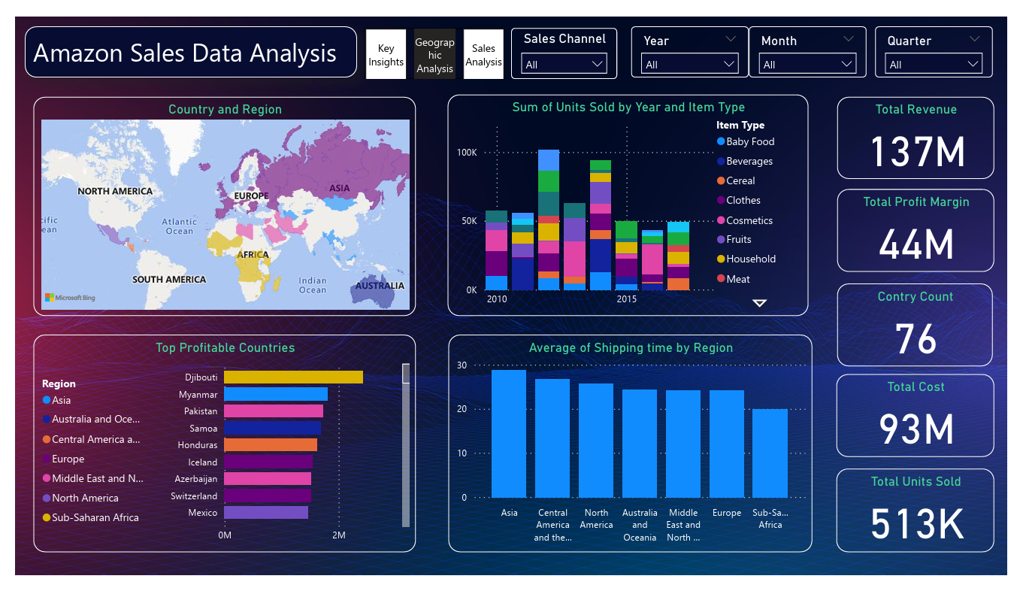
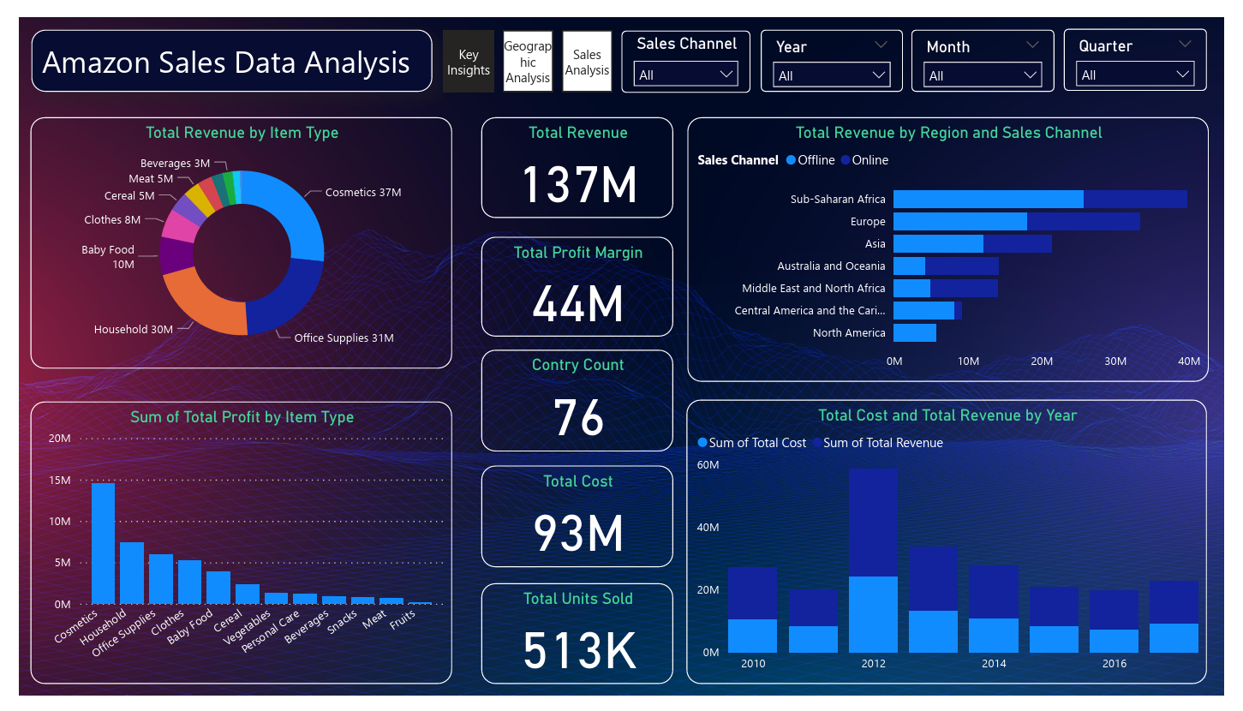
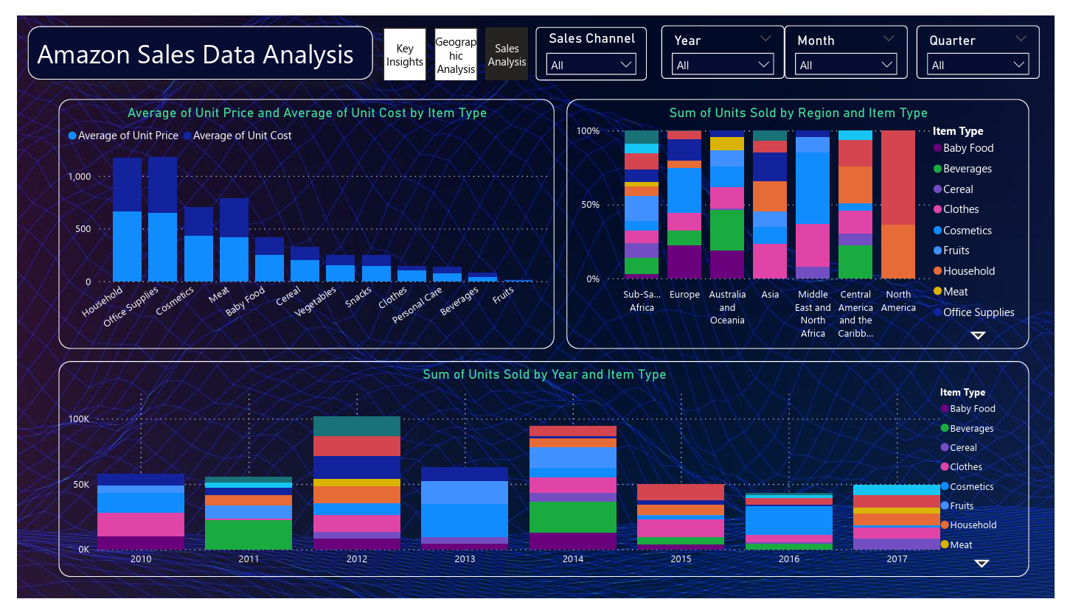
My power BI dashboard

Slide 14
Conclusion
Notable disparities in average unit prices were observed across item types, with Household having the highest average unit price at 668.27 and Fruits at the lowest with 9.33.
The positive correlation between the average unit price and average unit cost suggests a consistent trend where higher prices align with higher costs.
The most significant divergence between average unit price and average unit cost occurred for Cosmetics, indicating unique pricing dynamics for this item type.
Household items stood out with the highest average unit price, showcasing a substantial difference compared to other item types, particularly Fruits.
The wide range of average unit prices (9.33 to 668.27) and average unit costs (6.92 to 524.96) emphasizes the diverse pricing strategies and cost structures across the 12 item types.

